Slide 1
Cache Memory Management
Direct Mapped Cache
Fully Associative Cache
Set Associative Cache

Slide 2
GATE 2017
A cache memory unit with capacity of N words and block size of B words is to be designed. If it is designed as direct mapped cache, the length of the TAG field is 10 bits. If the cache unit is now designed as a 16-way set-associative cache, the length of the TAG field is ______ bits.
A. 12
B. 14
C. 16
D. 18

Slide 3
Answer: (B)

Slide 4
Question (GATE 2021)
Consider a set-associative cache of size 2KB (1KB=2¹⁰ bytes) with cache block size of 64 bytes. Assume that the cache is byte-addressable and a 32 -bit address is used for accessing the cache. If the width of the tag field is 22 bits, the associativity of the cache is _________ .
(A) 2
(B) 4
(C) 1
(D) 8

Slide 5
Answer: A

Slide 6
GATE 2007
Consider a 4-way set associative cache consisting of 128 lines with a line size of 64 words. The CPU generates a 20-bit address of a word in main memory. The number of bits in the TAG, LINE and WORD fields are respectively:
(A) 9,6,5
(B) 7, 7, 6
(C) 7, 5, 8
(D) 9, 5, 6

Slide 7
Answer: D

Slide 8
GATE 2008
Consider a computer with a 4-ways set-associative mapped cache of the following characteristics: a total of 1 MB of main memory, a word size of 1 byte, a block size of 128 words and a cache size of 8 KB.
The number of bits in the TAG, SET and WORD fields, respectively are:
(A) 7, 6, 7
(B) 8, 5, 7
(C) 8, 6, 6
(D) 9, 4, 7

Slide 9
Answer: D

Slide 10
Question
A 4-way set-associative cache memory unit with a capacity of 16 KB is built using a block size of 8 words. The word length is 32 bits. The size of the physical address space is 4 GB. The number of bits for the TAG field is _____
(A) 5
(B) 15
(C) 20
(D) 25

Slide 11
Answer: C

Slide 12
GATE 2016
The width of the physical address on a machine is 40 bits. The width of the tag field in a 512 KB 8-way set associative cache is ____________ bits Ans.D
(A) 24
(B) 20
(C) 30
(D) 40

Slide 13
RISC and CISC

Slide 14
Reduced Instruction Set Architecture (RISC)
The main idea behind this is to make hardware simpler by using an instruction set composed of a few basic steps for loading, evaluating, and storing operations just like a load command will load data, a store command will store the data.
RISC: Reduce the cycles per instruction at the cost of the number of instructions per program.

Slide 15
Complex Instruction Set Architecture (CISC)
The main idea is that a single instruction will do all loading, evaluating, and storing operations just like a multiplication command will do stuff like loading data, evaluating, and storing it, hence it’s complex.
Both approaches try to increase the CPU performance
CISC: The CISC approach attempts to minimize the number of instructions per program but at the cost of an increase in the number of cycles per instruction.

Slide 16


Slide 17
Characteristic of RISC
Simpler instruction, hence simple instruction decoding.
Instruction comes undersize of one word.
Instruction takes a single clock cycle to get executed.
More general-purpose registers.
Simple Addressing Modes.
Fewer Data types.
A pipeline can be achieved.

Slide 18
Characteristic of CISC
Complex instruction, hence complex instruction decoding.
Instructions are larger than one-word size.
Instruction may take more than a single clock cycle to get executed.
Less number of general-purpose registers as operations get performed in memory itself.
Complex Addressing Modes.
More Data types.

Slide 19
RISC | CISC
Focus on software | Focus on hardware
Uses only Hardwired control unit | Uses both hardwired and microprogrammed control unit
Transistors are used for more registers | Transistors are used for storing complex Instructions
Fixed sized instructions | Variable sized instructions
Can perform only Register to Register Arithmetic operations | Can perform REG to REG or REG to MEM or MEM to MEM
Requires more number of registers | Requires less number of registers
Code size is large | Code size is small
An instruction executed in a single clock cycle | Instruction takes more than one clock cycle
An instruction fit in one word | Instructions are larger than the size of one word

Slide 20
What is Pipelining
Pipelining is accumulating the instructions from the processor through a pipeline or a data pipeline. A Pipeline is a set of data processing units arranged in series such that the output of one element is the input of the subsequent element. Pipelining is a technique in which multiple instructions are overlapped during execution. It is used primarily to create and organize instructions in a processor so that the processes run in concurrent fashion. Basically, Pipelining is a process to manage the addition of new tasks frequently by removing the completed tasks.

Slide 21
Difference between Pipelining and Non-Pipelining
Pipelining System | Non-Pipelining System
In pipelining system, multiple instructions are overlapped during execution. | In a Non-Pipelining system, processes like decoding, fetching, execution and writing memory are merged into a single unit or a single step.
Many instructions are executed at the same time | Only one instruction is executed at the same time
The efficiency of the pipelining system depends upon the effectiveness of CPU scheduler. | In a Non-Pipelining system, The CPU scheduler chooses the instruction from the pool of waiting instructions, when an execution unit gives a signal that it is free. The efficiency is not dependent on the CPU scheduler.
Execution time is comparatively less and execution is done in a fewer cycles | Execution takes more time or more number of cycles comparatively

Slide 22
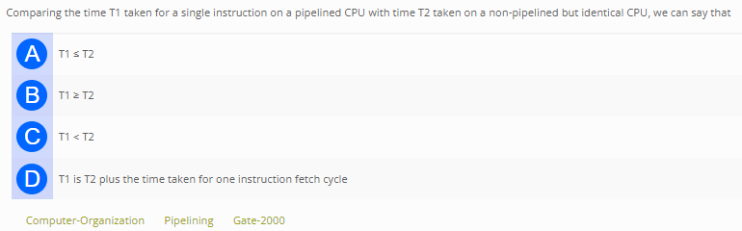
Question: GATE2000

Slide 23
Answer: B

Slide 24
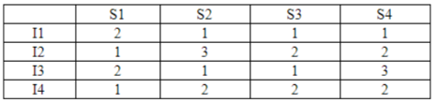
Question (GATE2009)
Consider a 4 stage pipeline processor. The number of cycles needed by the four instructions I1, I2, I3, I4 in stages S1, S2, S3, S4 is shown below:
What is the number of cycles needed to execute the following loop?
for (i=1 to 2) { I1; I2; I3; I4; }
A. 16 B. 23
C. 28 D. 30

Slide 25
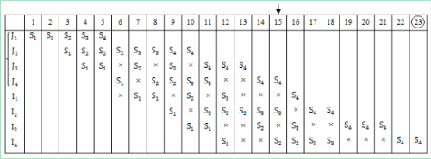
Answer: B

Slide 26


